Slide 1
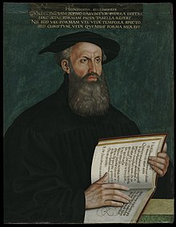
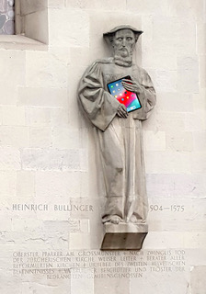
LLMs for Bullinger Digital
Martin Volk & Dominic Fischer
Elainne Vibal
Patricia Scheurer & Phillip Ströbel & Anastassia Shaitarova
Raphael Müller & Bernard Schroffenegger

Slide 2
Politics / News Johannes Haller (Bern) to Bullinger; May 28, 1551
Haec ex Augusta. Item das die bottschafft uß Schweden noch ligg und antwort warte. Hertzog Christoff ist verritten. Hiezwüschend schript Dietrich Marcell dem Musculo, der printz sye zuͦ Ausgpurg schon verritten.
Gester sind kaufflüth von Augspurg hie glegen, kömmend von Lyon, sagend, es sye frid zwüschend dem bapst und dem küng von Franckrych;
ChatGPT: “This is from Augsburg. Likewise, the message from Sweden is still pending, and a response is awaited. Duke Christoph has ridden away. Meanwhile, Dietrich Marcell writes to Musculus that the prince has already ridden to Augsburg.
Yesterday, merchants from Augsburg were here, coming from Lyon, saying that peace has been made between the Pope and the King of France.”

Slide 3
The Plague Bullinger to Josua Keßler; October 31, 1564
Apud nos pergit, ut coepit, pestis; passim multos involvit et abripit. Hac nocte mortua est filia mea Margarita, Lavateri nostri Ludovici uxor; vi morbi adacta infantulum est enixa, fuit enim praegnans, et peperit satis feliciter pridie abhinc. Infantulus mox a baptismo excessit; ipsa mater consequta est hora noctis 11; reliquit marito parvulos 7. Unde coniicis, quantis exercear moeroribus.
ChatGPT: “The plague continues here as it began; it seizes and takes away many everywhere. Last night, my daughter Margarita, the wife of our Ludwig Lavater, passed away; forced by the severity of the illness, she gave birth to an infant, for she was pregnant, and delivered successfully the day before yesterday. The infant passed away soon after baptism, and the mother followed at 11 o'clock that night. She left behind seven young children for her husband. From this, you can imagine the depth of my sorrows.”
Notes:
split person name

Slide 4

Food and Family Bullinger to his son Hans Rudolf; December 1, 1565
Gott mitt uns. Fürgeliepter sun, dinen brieff sampt dem fisch und räbhin, hab ich empfangen sagen dir und diner Susanna grossen danck und wöllend wil es, die nacht ässen und gott einandren, alle zuͦ nacht ässen und gott dancken. Es ist mir aber annd, das ich der dargägen diser zyt nüt schicken kan;
ChatGPT: “God be with us.
Dearest son, I have received your letter along with the fish and the little bunch of grapes. I give you and your Susanna great thanks. If God wills it, we will eat them tonight and give thanks to God together with everyone at supper.
However, it troubles me that I am unable to send anything in return at this time.”
Notes:
HTR Letter; räbhin != little bunch of grapes (but rather Rebhuhn = turkey)

Slide 5

Reformers (and their letter correspondences)
Martin Luther (1483-1546): 63 years - 4300 letters
Huldrych Zwingli (1484-1531): 47 years - 1300 letters
Heinrich Bullinger (1504-1575): 71 yrs - 12’000 letters
Johannes Calvin (1509-1564): 55 yrs - 4200 letters
Notes:
Quelle: T. Schieß (1932): Der Briefwechsel Heinrich Bullingers
1369 von Calvin selbst

Slide 6
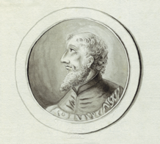
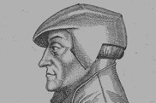
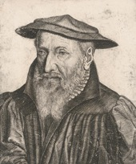

Bullinger’s Letters
2000 Letters
by Bullinger
Heinrich Bullinger
1504-1575

Slide 7
Bullinger’s Letter Collection
10’000 Letters
to Bullinger
Heinrich Bullinger
1504-1575

Slide 8
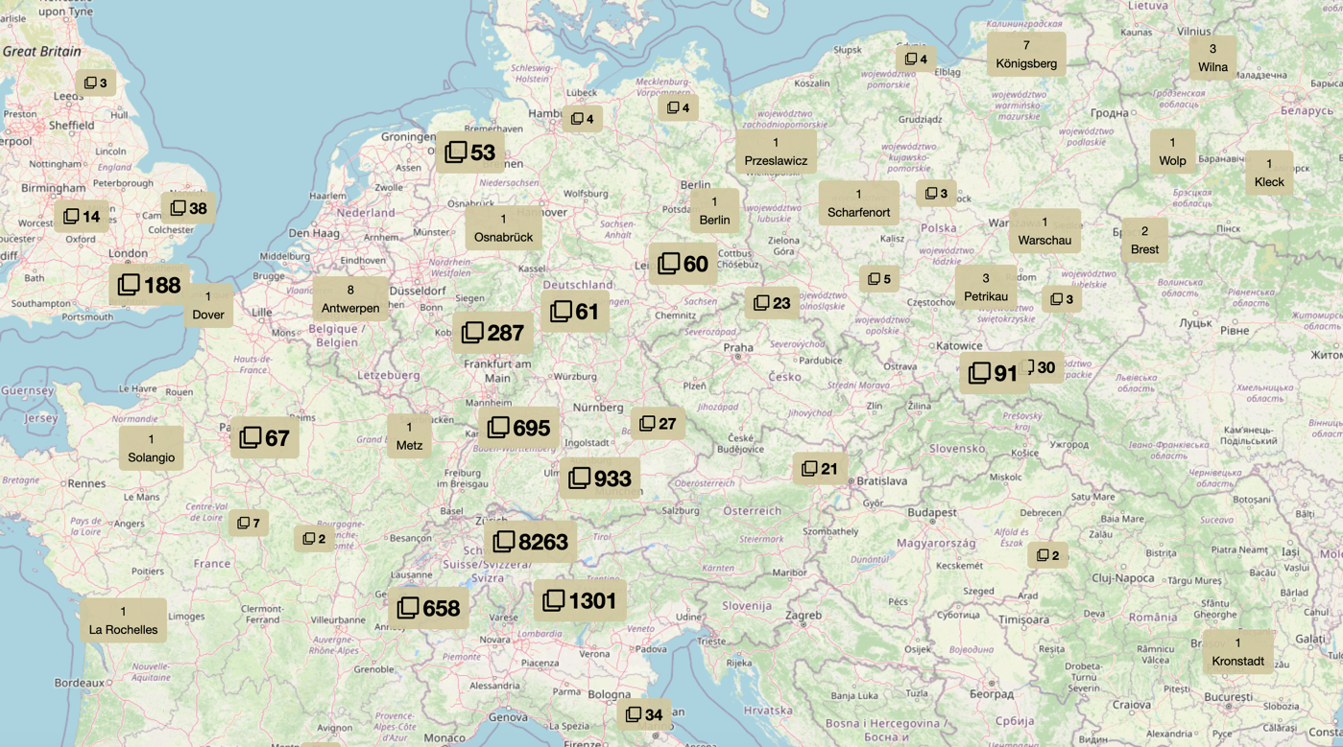
Bullinger’s Correspondence Network
Notes:
Numbers indicate the count of sent letters from a region.

Slide 9
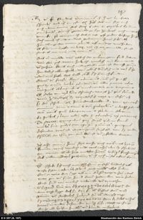
Starting Point for Bullinger Digital
3100 letters manually transcribed with summary (in German) and 75’000 comments (in German)
5400 letters manually transcribed
~ 3000 letters with automatic handwriting recognition (→ Phillip Ströbel’s PhD)

Slide 10
Starting Point for Bullinger Digital
Languages of the Letters
75% in Latin
24% in Early New High German
often mixed !!!
few letters in other languages (French, Italian, Greek)
Note: Spelling in Latin is “standardized”;
but ENH-German is write-as-you-speak. ☺

Slide 11
Language Attributes in our XML Corpus
<s n="19" xml:lang="la"><foreign xml:lang="de">Mögend wir behoupten, das man die pfründen naach anzal der personen theile, so hand wir groß glück;</foreign> nam ut consul mihi in sinum dixit, pontificii se in eo negocio dies noctesque exercent, ut impediant hoc consilium. </s>
<s n="20" xml:lang="de"><foreign xml:lang="la">Et quod pessimum est,</foreign> man muͦß vorhin uff die gmeinden ußschryben. </s>
Source: Letter 3695 from Johannes Fabricius Montanus to Heinrich Bullinger

Slide 12
Profiling the Letters according to Code-Switching

Slide 13
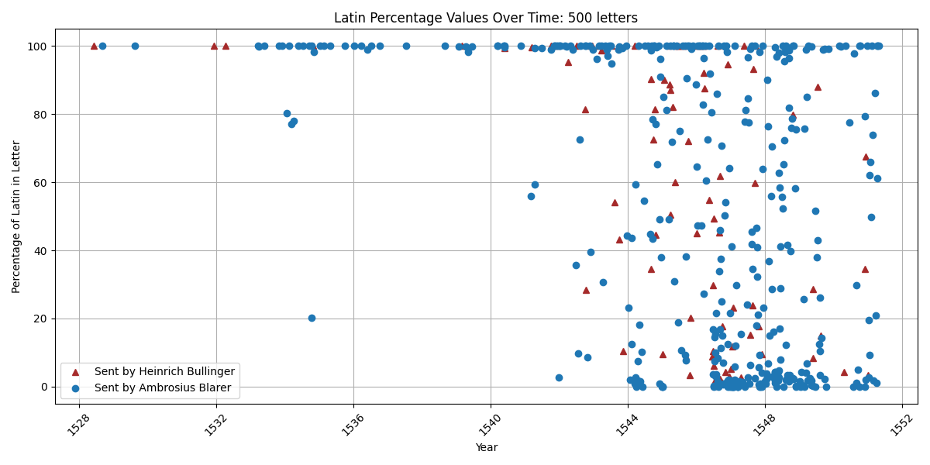
C-S Profile for Ambrosius Blarer (Constance)

Slide 14
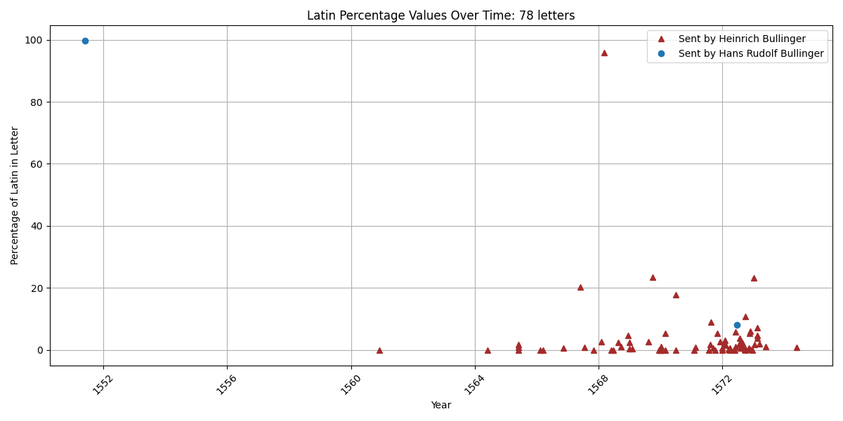
C-S Profile for Hans Rudolf Bullinger (son)

Slide 15
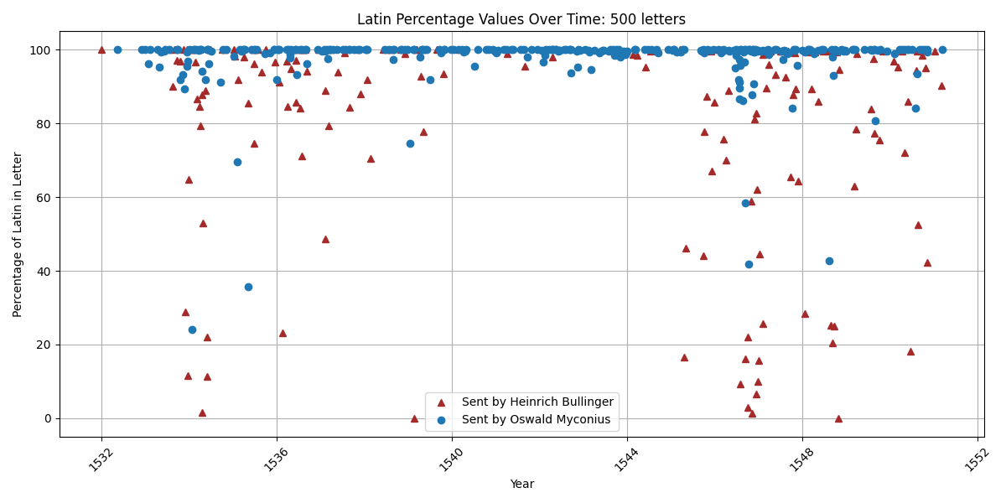
C-S Profile for Oswald Myconius (Basel)

Slide 16
Loanwords: ENH-German Words in Latin
Rumor apud nos est Caesarem esse Argentorati cum 10 regimentis landsknechtiorum equitibusque mille quingentis; quodque primo tempore invasusurs sit margtgravium.
[Simprecht Vogt / Schaffhausen an Heinrich Bullinger / Zürich, 21. September 1552]
ChatGPT: "There is a rumor here that the Emperor is in Strasbourg with 10 regiments of landsknechts and 1,500 cavalry; and that he will soon attack the margrave."
Notes:
ChatGPT (October 2024) with the prompt: ”Translate the following sentence to English”: …

Slide 17
Loanwords: ENH-German Words in Latin
MVolk:
But "landsknechts" is not an English word. Please translate the sentence including the German loanwords.
ChatGPT:
"There is a rumor here that the Emperor is in Strasbourg with 10 regiments of landsknechts (German mercenary soldiers) and 1,500 cavalry; and that he will soon attack the margrave (German nobleman)."

Slide 18
Loanwords: Latin Words in ENH-German
Wenn die pfaffen das requiem im kor hand, so sind gwärtig des gaudeamus in der kuchen.
[Gervasius Schuler (Scholasticus) / Lenzburg an Heinrich Bullinger / Zürich, 16. Februar 1559]
ChatGPT: "When the priests hold the Requiem (a mass for the dead) in the choir, the Gaudeamus (a celebration or joyful song) is already prepared in the kitchen.”
(Note: The phrase is a bit of a proverb or saying, implying a contrast between the solemnity of a religious service and the festivities or indulgence happening elsewhere, often behind the scenes.)

Slide 19
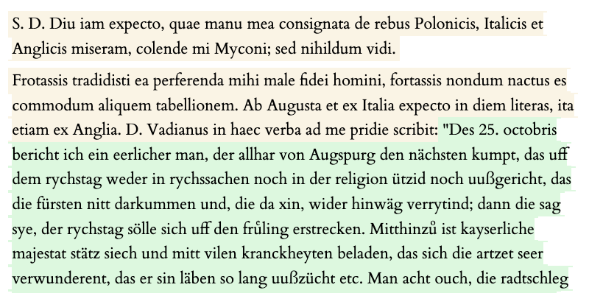
ChatGPT Translation ENH-German → German
Heinrich Bullinger an Oswald Myconius, 4. November 1550

Slide 20
Dear Sir,
I have been waiting for a long time to see the documents I sent about Polish, Italian, and English affairs, my dear Myconius, but I have not yet seen anything.
Perhaps you entrusted them to a person of bad faith to bring them to me, or perhaps you have not yet found a convenient notary. I am waiting for letters from Augsburg, Italy, and England every day. Mr. Vadian wrote to me yesterday as follows: "On October 25, an honorable man arrived from Augsburg who reports that nothing has been decided at the Reichstag concerning imperial affairs or religion, and that the princes are not coming, and those who do come are going back. They say that the Reichstag will be postponed until spring. At the same time, His Imperial Majesty is ill and burdened with many illnesses, and the doctors are very surprised that he has lived so long, etc. …

Slide 21
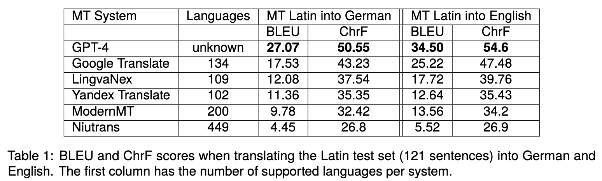
MT Latin – English / German (LREC 2024)
Note: An improvement of about 2 BLEU points will likely get your paper published.
GPT-4 outperforms Google Translate by a multiple of that!
Notes:
Test set: 121 sentences from 8 letters

Slide 22
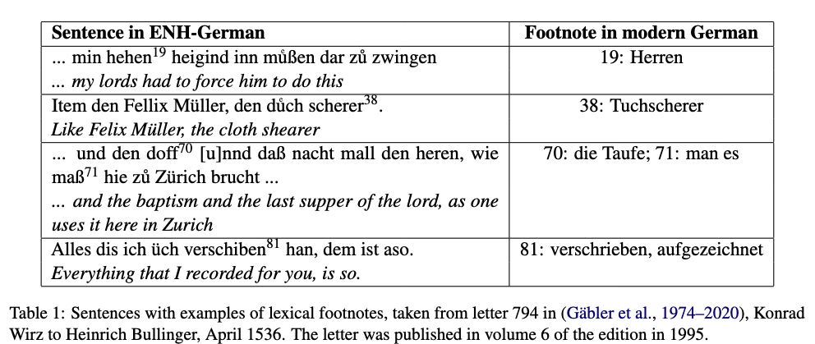
MT ENH-German → German (KONVENS 2024)

Slide 23
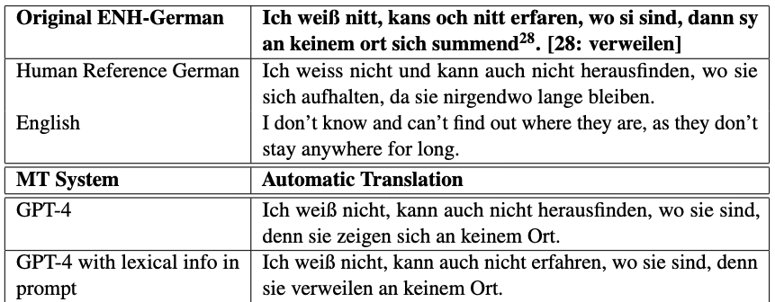
MT ENH-German → German (KONVENS 2024)
→ Improvement of 5 BLEU points with lexical info inserted in the prompt!

Slide 24
MT of Names (submitted to MT Summit 2025)
De synodo tamen Saxonica nihil accepi hactenus et ne Argentorati quidem (quo his diebus in Brisgaudiam Alsatiamque, illuc a marchionis Ernesti Badensis filia et vidua, huc vero a barono a Rapoltzstein vocatus ex occasione me contuli) quicquam huius intellexi neque eo d. Marpachius abiit, quem docentem audivi.
ChatGPT (Jan. 2025): "Regarding the Saxon synod, however, I have received no news so far, and even in Strasbourg (to which I recently traveled on occasion, called to Breisgau and Alsace, there by the daughter and widow of Margrave Ernest of Baden, and here by the Baron of Rapoltsweiler), I learned nothing about it. Nor has Mr. Marbach gone there, whom I heard teaching."
Notes:
(letter 2292) note ‘Argentorati’ → Strasbourg, Alsatiamque with suffix, Ernest _of_ Baden,

Slide 25
Spelling variations
Ante proximas meas tibi cum Cunraadto Zvigkio nostro elapso ferme bimestri scripsimus et rationem fidei nostrę chartis mandatam transmisimus, …
ChatGPT: About two months ago, before my most recent letter, we wrote to you along with our Conrad Zwick and sent you a written account of our faith, …

Slide 26
Experiments – The Prompt
Translate the following sentence from <language> into modern German.
Make sure to translate proper nouns into their modern German equivalents.
Pay special attention to the proper noun(s) <name(s)>.

Slide 27
Experiments - Results
Prominent names (bigger cities, persons with Wikipedia pages) are better translated than others.
Providing historical background in the prompt (“the letter is from the reformation time, 16th century …”) improves translation quality.
… So does Adding the summary (”Regest”) to the prompt.
Adding bio- or topographical information (e.g. from an edition note) improves name translation accuracy greatly.
Example: Note that the proper noun Tigurinę refers to Zurich and translate it accordingly.

Slide 28
Special: Discontiguous Person Names (~ 200)
"Cum superioribus diebus literas darem ad Ambrosium nostrum Blaurerum, nihil tibi scribere potui, …
ChatGPT: 'When I wrote recently to our Ambrosius Blaurer, I could not write to you, …
--------------
Trecium nostrum Christopherum, obsecro, quam citissime ad nos cum responsis expedite.
ChatGPT: "Send our Christopher to us as quickly as possible, I beg you, with the replies."
→ Trecius is missing! ☹

Slide 29
Special: Person Names with Location
Copiosiores literas adferet d. Thomas Leverus Anglus, cui heri tibi ferendas tradidi.
ChatGPT: More detailed letters will be brought by Mr. Thomas Lever, the Englishman, to whom I handed them yesterday for you.

Slide 30
Special: Names with Suffix –que (~ 120)
De Burchero Burcherique rebus ad Burcherum nunc scribo.
ChatGPT: "I am now writing to Burcher about Burcher and his affairs."
------------------
Salutat te Comander Tschernerusque et Traversus nuper mihi hoc mandans, iunior inquam.
ChatGPT: "Commander Tscherner and Traversus greet you, the latter recently giving me this message, namely the younger one, I mean."
→ The system gets confused with "Comander" and misses the conjunction.

Slide 31
Triadic Greetings
Sender
Addressee
Letter 2017 (18.09. 1553) Johannes Haller → Heinrich Bullinger
Saluta d. Gvaltherum, Pellicanum, Theodorum, generos quoque tuos omnes ex me.
Addressees of Greetings
Notes:
generos = sons in law

Slide 32
Triadic Greetings
Sender
Addressee
Senders of Greetings
Letter 215 (3.08. 1548) Ambrosius Blarer → Heinrich Bullinger
Salutant te nostri, praecipue mea uxor et Conradus Zviccius.

Slide 33
Who sends greetings? “Mark the info in the XML”
Input
<s n="30"><pers ref="p5565">Capito</pers> nuper ad me scribens iussit te diligenter salutare, denique et <pers ref="p1753">Leonem</pers> ipsum iuncto <pers ref="p8171">Theodoro</pers>, quos etiam meo nomine salvere iubeas.</s>
ChatGPT
<s n="30"><pers ref="p5565" sent="from">Capito</pers> nuper ad me scribens iussit te diligenter salutare, denique et <pers ref="p1753" sent="to">Leonem</pers> ipsum iuncto <pers ref="p8171" sent="to">Theodoro</pers>, quos etiam meo nomine salvere iubeas.</s>
Notes:
Capito recently wrote to me and instructed me to greet you warmly. Finally, also Leo himself, together with Theodore, whom you should likewise greet on my behalf.

Slide 34
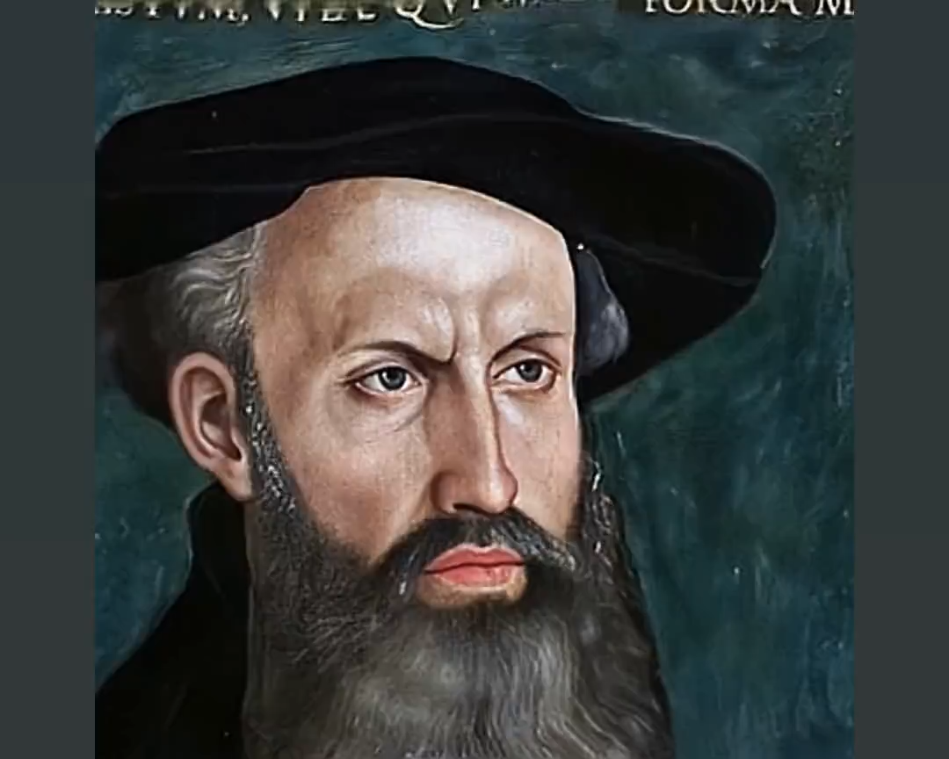

Slide 35
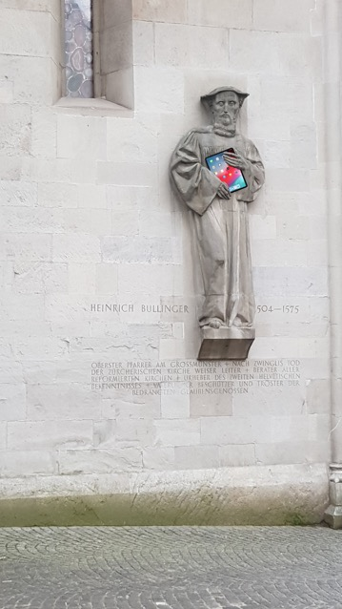
Vielen Dank!

Slide 36
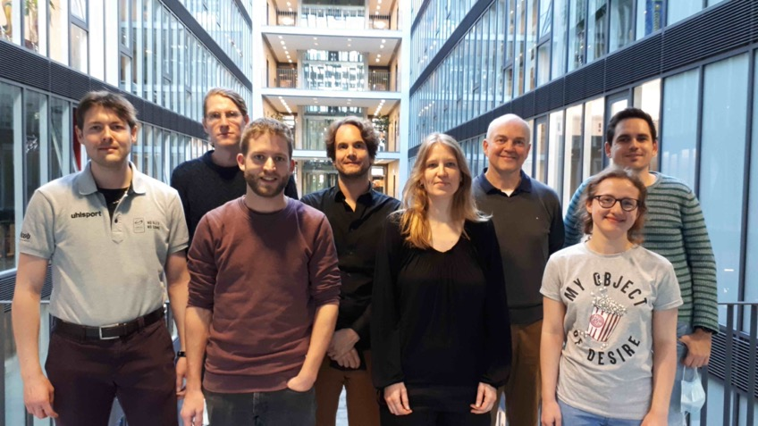
Team Bullinger Digital
Phillip Ströbel
Bernard Schroffenegger
Raphael Müller
Raphael Schwitter
Patricia Scheurer
Martin Volk
Angela Heldstab
Lukas Fischer
In addition for Automatic Handwriting Recognition
Tobias Hodel + Team (Uni Bern)
Andreas Fischer + Team (FH Fribourg)

Slide 37
Thanks to our Students
Ismail Prada, Sabina Brändle, Benjamin Suter, Eyal Dolev, Donn Edvard Anin, Antonia Popp, Elainne Vibal, Dominic Fischer, Jana-Maria Humbel

Slide 38
Bullinger-digital: Technology
Handwritten Text Recognition: Transkribus, TrOCR
PDF → XML Conversion: Tetlib, pdf2html
OCR: Abbyy FineReader
Machine Translation: Sockeye, Transformer Models
Database: SQLite + Elastic Search
Frontend: ReAct
XML-Editor: Oxygen
Programming Language: Python

